Slide 1

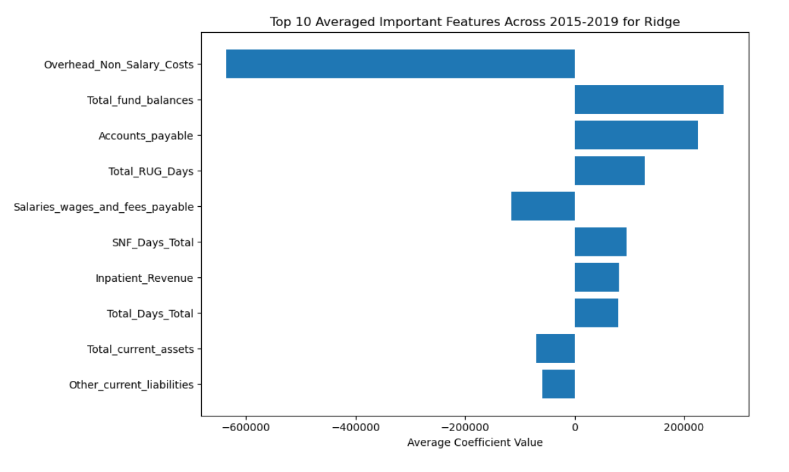
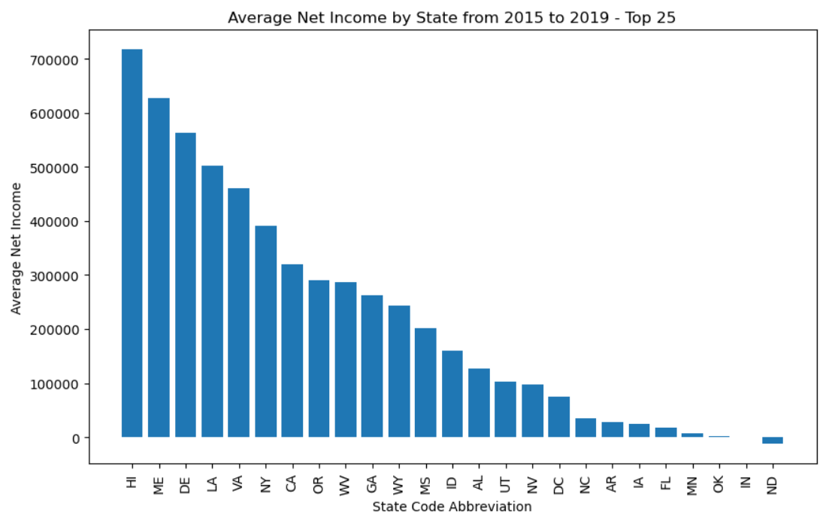
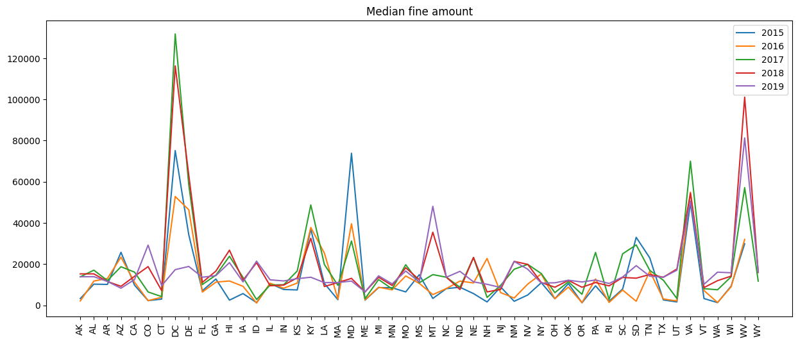
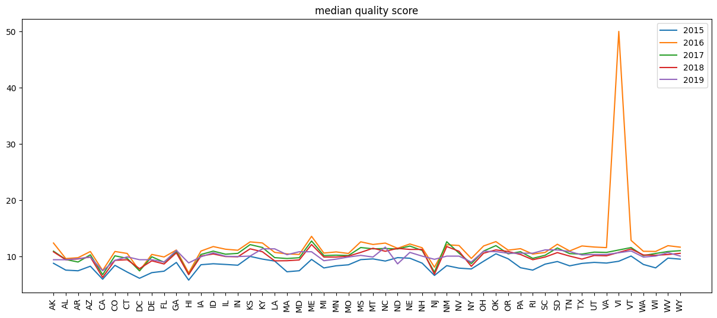
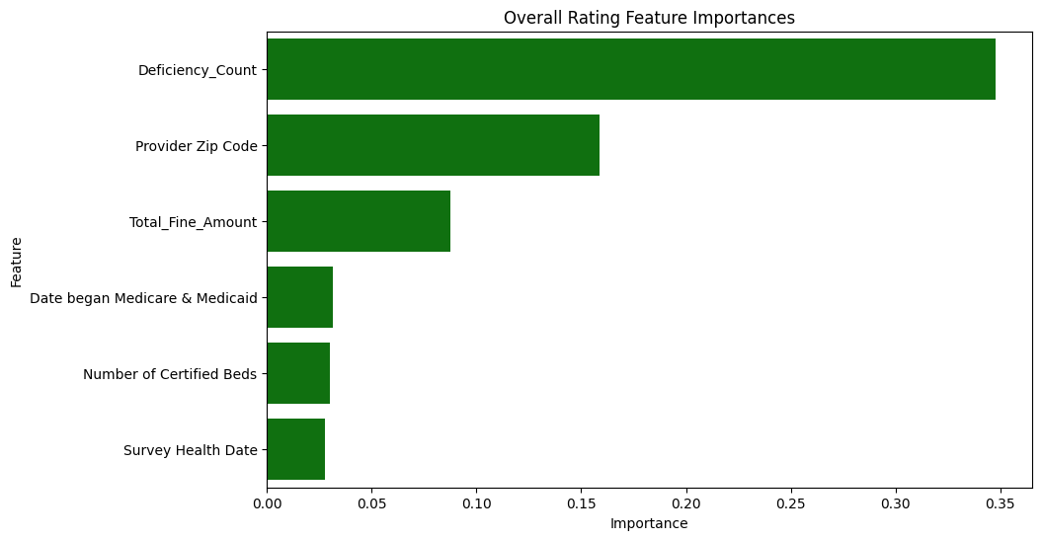



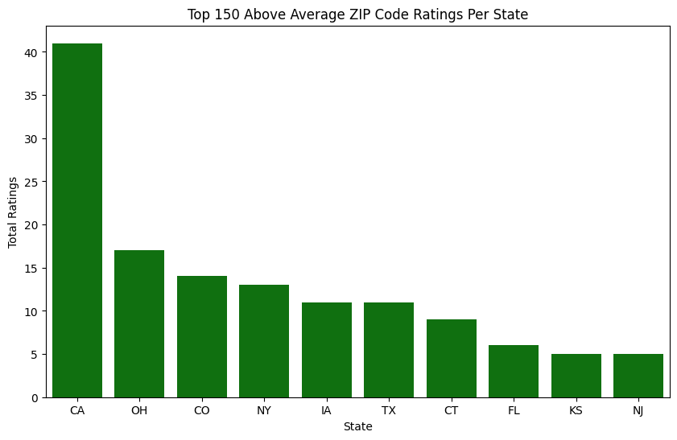



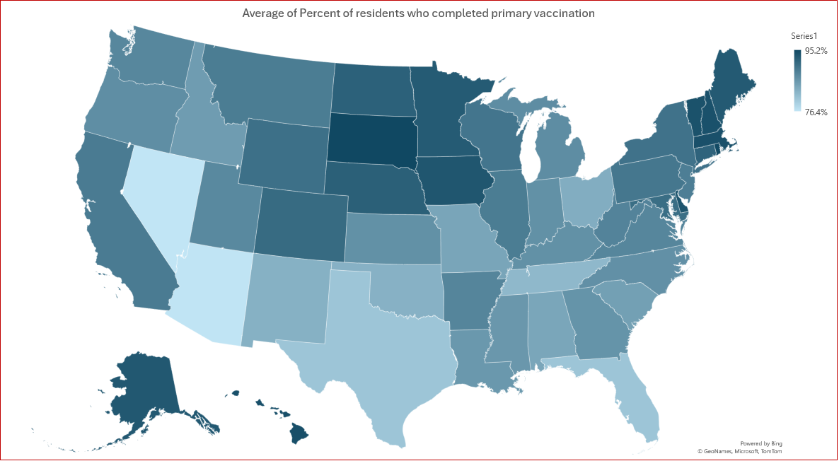
How Reliable are Nursing Homes as an Investment?
2024 Business Analytics Competition @ Manhattan College
Presenters: Sam Biner, Andrew Kim, Sam Nielsen, Iris Gallagher
Advisors: Dr. Mesgari
Story
Geri Attrick’s Data Analytics team was tasked with figuring out if nursing homes and the elder care market could be a potentially profitable investment. To do this, we:
.
Explored the data
Defined clear questions to guide our analysis
Used predictive modeling to find the best states and zip codes
Answer if nursing homes and the elder care market is a good investment opportunity
1: How Did Different States Respond to COVID?
3: How Profitable are Nursing Homes as a Business?
Step 1:
First, when exploring the outlier data sets of the COVID-19 vaccine information, we started the analysis at the state level.
Step 2:
We found that states in the Northeast, West Coast, and Mid-West had a quicker adoption of vaccines. We wanted to continue analyzing to see if these states provided high returns.
Step 1:
First, to provide a better recommendation on the specific nursing homes to invest in, we wanted to see what features impact Net Income the most. We found that high non-overhead salary costs had a strong negative correlation while high total fund balances and accounts payable balances were positively correlated.
Step 2:
Continuing with the same years of data, we found that of the top 4 states we previously selected, New York and California were 6th and 7th of the most profitable states on average.
Step 3:
We decided to focus on these two states for our recommendations while also including Colorado and Ohio as comparisons.
Questions
How did different States respond to COVID-19?
What features affect Overall Rating the most?
How profitable are Nursing Homes as a business?
What is the expected return?
2: What Features Affect Overall Ratings the Most?
Step 1:
To continue our state-by-state analysis, we looked at the fine amounts and quality scores, seeing if they were relatively consistent during the analysis period. We decided to exclude 2020 and 2021 as outliers from COVID-19. We expect the data to return to normalcy in the coming years.
Step 2:
We found a consistent pattern from each state on both metrics, so we looked more into the overall rating per each nursing home.
Step 3:
Next, we decided to find the feature importance for the Overall Rating of nursing homes, where we found that the top 3 features, Deficiency Count, Provider Zip Code, and Total Fine Amount, play a pivotal role.
Step 4:
To further our analysis on the state-by-state level, we investigated specific states with the most amount of above-average Overall Score which is defined as above 3, while considering the feature importance.
Step 5:
We found that California, New York, Ohio, and Colorado were the strongest. Before determining if these states provided a good investment opportunity, we wanted to make sure that they were profitable.
Conclusion
We recommend adding nursing homes into your investment portfolio, only if the following criteria are met.
Focus on states that are more up to date with the COVID vaccine
Avoid states with low-quality scores that pay high amounts of fines
Pay close attention to these variables: Deficiency counts, Zip Code, Total Fine Amounts, Date of Medicaid and Medicare, Number of Beds
Only look at states that had a positive Net Income
For safety, only consider investing if the overall score is 3 or more
We recommend the New York Zip codes given these qualifications. Specifically, the Bronx and Queens zip codes are given to generate the highest return.
4: What is the Expected Return of This Investment?
Step 1:
To determine the financial performance of nursing homes in the selected states, we focused on Return on Investment and Return on Assets. To do this, we used the Random Forest Regressor as the model in our analysis with the feature importances from the previous questions.
Step 2:
We found that New York was consistently better on average as an investment with these metrics when compared to the other top 3 states including California, so we decided to find the best Zip Codes for New York.
Step 3:
Specifically, we found that the Bronx and Queens zip codes 10463 and 11354 provided the highest returns for investors which is where we recommend investing.
Tools Used
Further Analysis
We would like to have access to the 2022 and 2023 datasets as it would help us normalize the impact of COVID-19 and do more predictive analytics for 2024 and 2025.
Additionally, we would like to have more data about turnover at an individual facility level.

